Slide 1
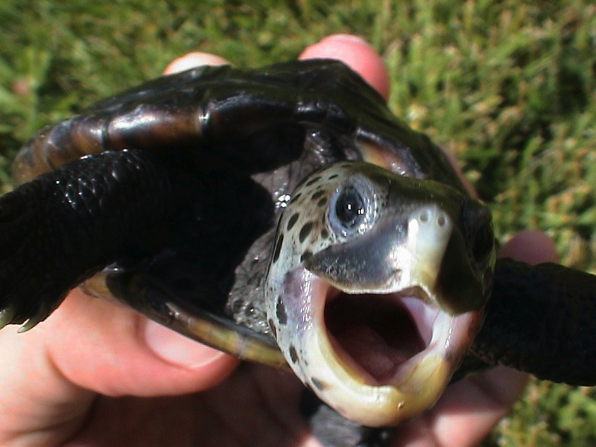
Terrapin Game Collection Management and Administration CS 5551 - Adam Carter

Slide 2
Motivation and Overview
Passion Project – Board Games
Collection Management is a Difficult Task
Very Poor Tool Support, unlike numerous other Collection-based hobbies
Game Information highly fractured on Internet

Slide 3
Project Goals
Consolidate Game Data and combine with Retailer Data
Allow users to build/manage own collection
Allow users to build a wishlist that shows vendor data
Use collection data to generate recommendations

Slide 4
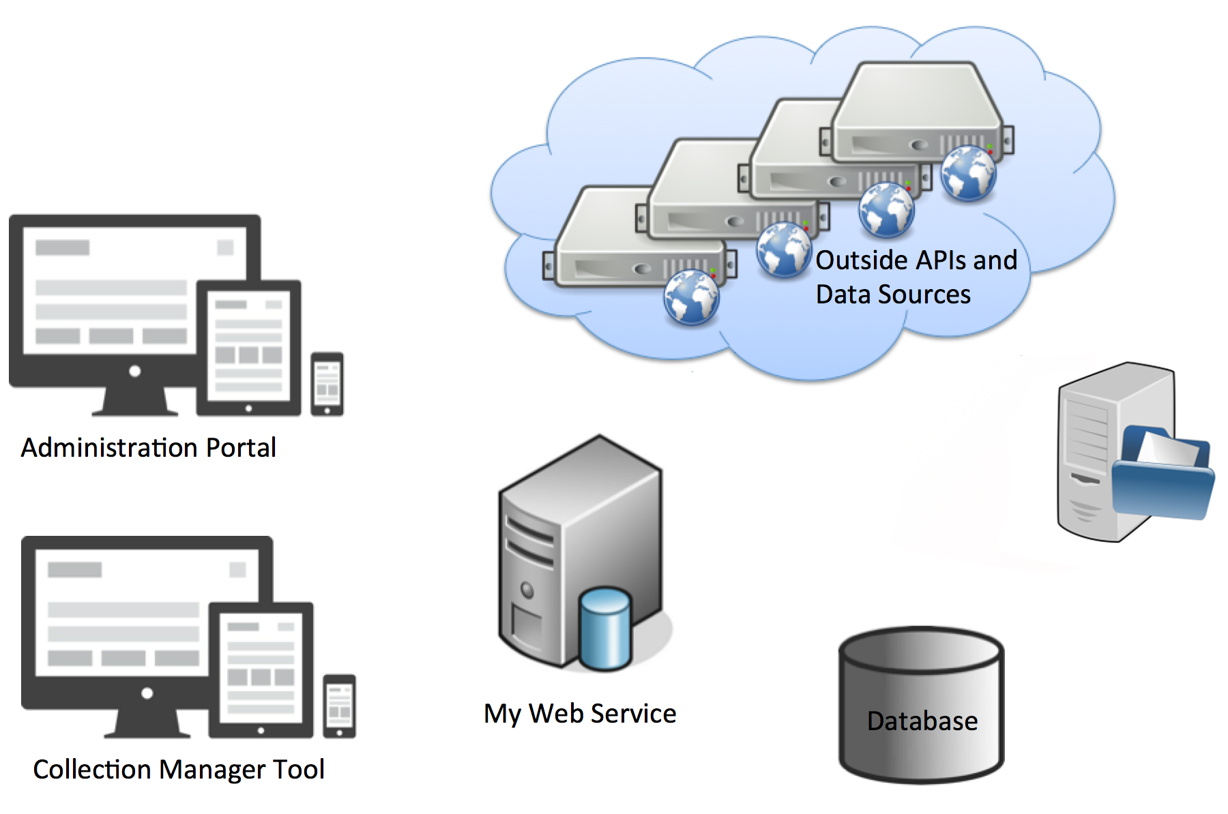
System Architecture
Agent Service

Slide 5
Technology Overview
Front-end Client:
HTML5, JavaScript, BootStrap, jQuery, jQuery-UI
Responsive Layout and Design
16 pages in Total
REST Service
Java using SpringBoot
14 Distinct REST endpoints
MongoDB NoSQL Storage
11 Tables
Background Agent ThreadPool
11 Regular Tasks scheduled every 3 hours
3 Primary External Data Sources

Slide 6
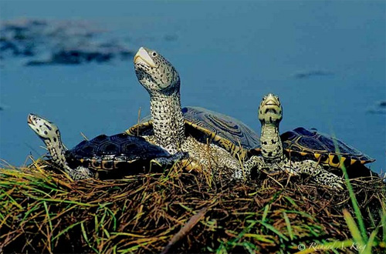
Demonstration

Slide 7
Challenges and Future Work
Inconsistent Source Data
----
Incorporation of additional Vendor sources
Increased Coordination with BoardGameGeek
Inclusion of additional data sets, like Game Media and Game Play Tracking
Improving Agent Auto-Recognition algorithm

Slide 8
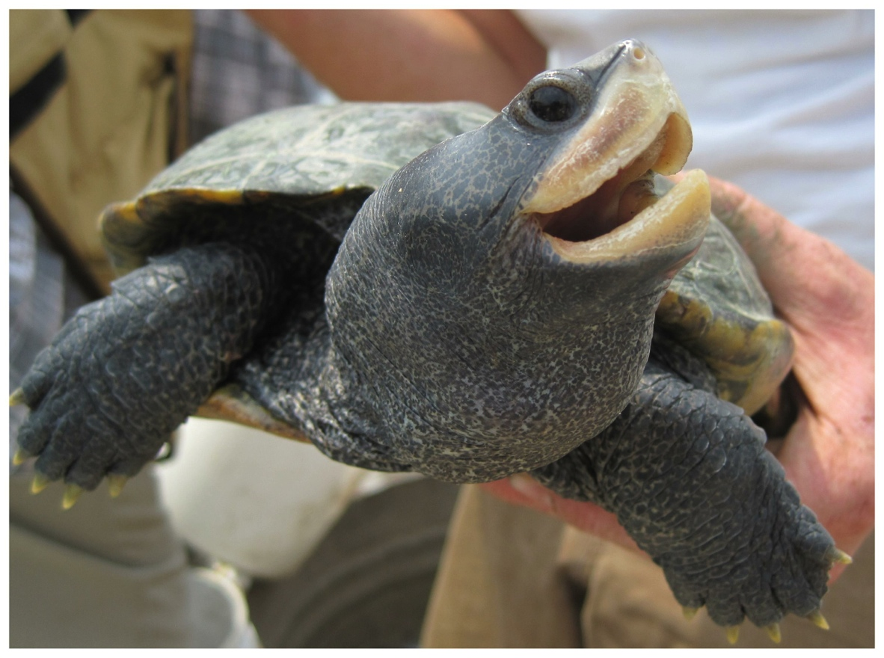
Questions?

